Slide 1
Searchable Web sites Recommendation
Date : 2012/2/20
Source : WSDM’11
Speaker : I- Chih Chiu
Advisor : Dr. Koh Jia-ling

Slide 2
Index
Introduction
Data Collection
Recommendation Framework
Feature Generation
Component Breakdown
Experiment
Conclusion

Slide 3
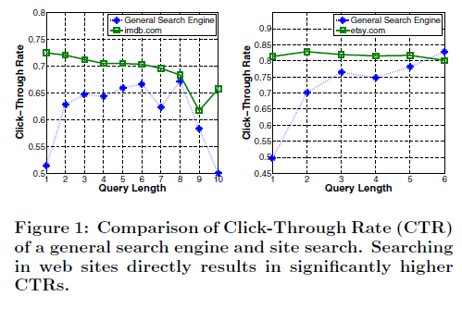
Introduction
imdb & etsy
E.g. webmd.com for health related questions, walmart.com for things to buy, etc.

Slide 4
Introduction
Motivation
Users often do not know which domain-specific sites to go to.
Goal
It is to discover, rank and recommend relevant searchable web sites to users.

Slide 5
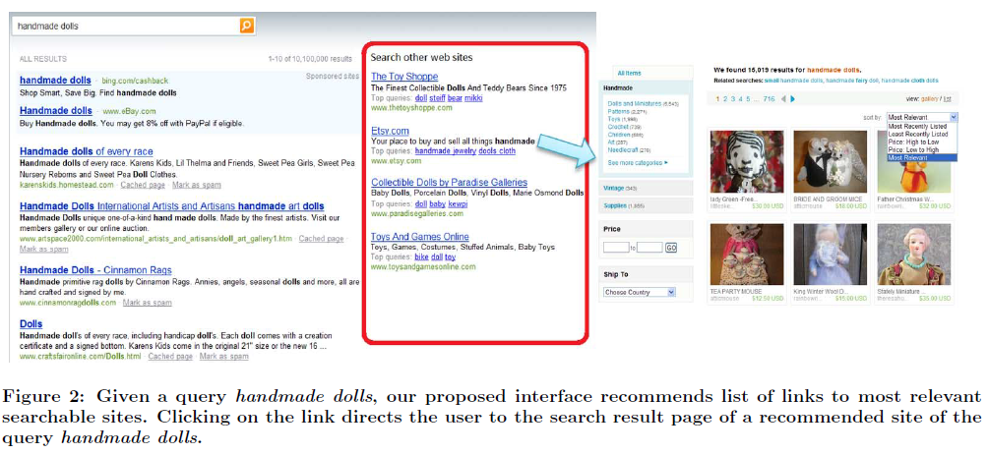

Slide 6
Data Collection
The log data is the client-side browsing log collected from millions of opt-in users of a world-wide distributed browser.
Each activity in a session records the following information : unique user id, clicked url, referred url, IP address, time stamp.
User tasks : search trails and non-search trails.

Slide 7
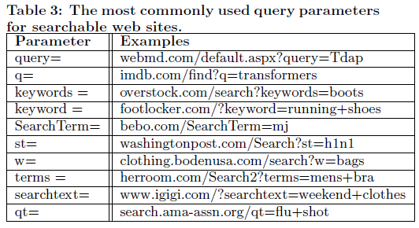
Data Collection
Only focus on the most discriminative parameter for each specialized engine.
E.g. “query=audo+a6&zip=98034”
A set of 126 manually extracted patterns are used.

Slide 8
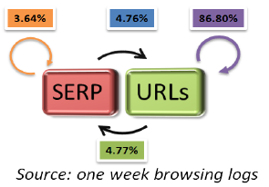
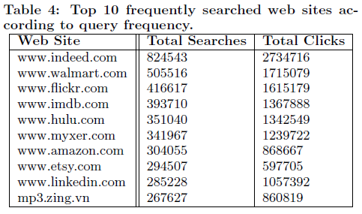
Data Collection
To collect one-week’s browsing log.
The data is over 20 Terabytes, with a total of 5 billion web page clicks.
To remove some well-known searchable sites from the list.
E.g. youtube.com, ebay.com and so on

Slide 9
Recommendation Framework
Feature Generation
Seven descriptive features
Components Breakdown
Model P(w|q) via Query Expansion
Model P(w|v) and P(w)
Optimize P(v) by Linear Feature Combination

Slide 10
Recommendation Framework
Feature Generation
A set of web sites users issued queries to, denoted as V .
A set of queries per web site, denoted as Q_{v} for a site v ∈ V .
Seven descriptive features :
queries(v) : the total number of queries.
unique queries(v) : the number of unique queries.
clicks(v) : the average number of clicks per query.
dt1(v) : the average dwell-time on the search result page per query.
dt2(v) : the average dwell-time on the referred links per query.
Index(v) : the number of web pages belong to the site.
entropy(v) : the entropy of the topic distribution.
700
100
100
100

Slide 11
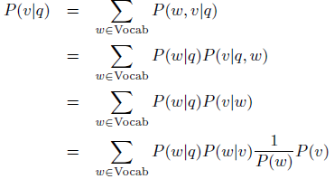
Recommendation Framework
Components Breakdown
The recommendation problem can be formulated as the conditional probability of a searchable web site v given a query q, P(v|q), as follows:
$$\frac{P(w,q)}{P(q)}∗\frac{P(v,q,w)}{P(q,w)}$$
Bayes’ rule
$$\left|v\right|=3,\{v1,v2,v3\}$$
$$\left\{q1,q2\right\}∈v1$$
$$\left\{q2,q3\right\}∈v2$$
$$\{q1,q3\}∈v3$$
$$P\left(v1 | q1,w1\right)=\frac{P(v1,q1,w1)}{P(q1,w1)}=\frac{1/6}{1/6}$$
$$\left\{w1,w2\right\}∈v1$$
$$\left\{w2,w3\right\}∈v2$$
$$\{w1,w3\}∈v3$$
$$P\left(v1 | w1\right)=\frac{P(v,w)}{P(w)}=\frac{1/6}{1/6}$$
Make an assumption that the term w and the query
string q represent redundant information

Slide 12
Recommendation Framework
Components Breakdown
Model P(w|q) via Query Expansion
Typical queries q → contain very few keywords
Expanded queries q* → snippets of the top-50 results
$$P\left(v | q\right)=\sum_{w∈Vocab}{P\left(w | q\right)P(w|v)\frac{1}{P\left(w\right)}P(v)}$$
Smoothing
Apple computer
Apple CEO
Apple iPhone
Apple iPod
Apple fruit
Orange country
Orange bear
Orange fruit
…etc.
Apple
Apple computer
Apple CEO
Apple iPhone
Apple iPod
Apple fruit
$$P\left(Apple|p∗\right)=$$
$$\frac{\frac{5}{5}}{\frac{5}{5}+\frac{1}{5}+\frac{1}{5}+\frac{1}{5}+\frac{1}{5}+\frac{1}{5}}$$
C : the entire expanded training query collection
w : orange , we can’t find in q*

Slide 13
Recommendation Framework
Components Breakdown
Model P(w|v) and P(w)
To utilize Q_{v} containing all submitted queries to the site v.
$\frac{1}{P(w)}$ is modeled as the inverse document frequency (idf).
$$P\left(v | q\right)=\sum_{w∈Vocab}{P\left(w | q\right)P(w|v)\frac{1}{P\left(w\right)}P(v)}$$
Q_{v} :
APPLE : 250
ASUS : 150
ACER : 100
HTC : 1500
$$P\left(HTC | v\right)=\frac{1500}{250+150+100+1500}=0.75$$
N is the total number queries
in the training collection.

Slide 14
Recommendation Framework
Components Breakdown
Optimize P(v) by Linear Feature Combination
To utilize seven informative features that are collected for each searchable site.
In order to learn the optimal weight [w₁, . . . ,w₇], they use the Simultaneous Stochastic Approximation (SPSA) algorithm proposed.
$$P\left(v | q\right)=\sum_{w∈Vocab}{P\left(w | q\right)P(w|v)\frac{1}{P\left(w\right)}P(v)}$$

Slide 15
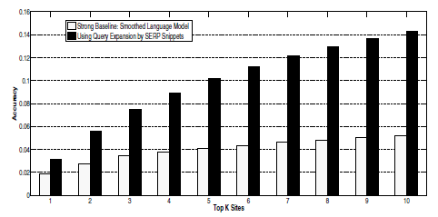
Experiment
QV = {(q₁, v₁), (q₂, v₂), . . . , (q_{n}, v_{n})} , the accuracy of the system with respect to the top K recommended sites.
TopVerticalK(q) is the set top K verticals returned by the ranking system.
On average, the query expansion improves the accuracy by 240%.

Slide 16
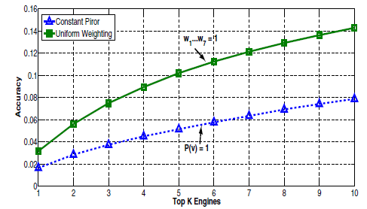
Experiment
$$P\left(v | q\right)=\sum_{w∈Vocab}{P\left(w | q\right)P(w|v)\frac{1}{P\left(w\right)}P(v)}$$
Constant Prior vs. Uniform Weighting
We observe that their system using uniform weighting performs significantly better than the one with constant prior.

Slide 17
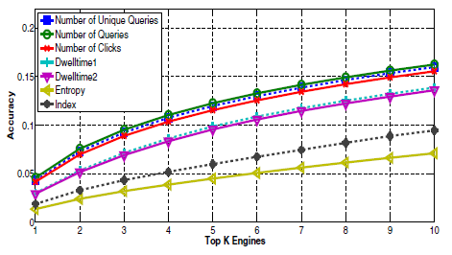
Experiment
Individual Feature Comparison
Assign w_{i} = 1 for the i^{th} feature and w_{h} = 0 (h $≠$ i) for all other features.

Slide 18
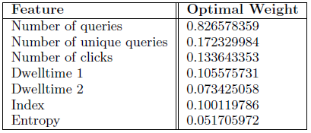
Experiment
Optimized Feature Combination
The optimal weights for the seven features
SPSA does not put normalization constraints on the weights, the summation of the seven weights is not equal to one.

Slide 19
Experiment
Summary
To list the performance improvement of the system using the weights trained by the SPSA algorithm.
$$P\left(v\right)=1$$
$$w1=w2=$$
$$…=w7=1$$
$$wi=1$$
$$wh=0,h≠i$$

Slide 20
Conclusion
A new methodology of discovering and recommending searchable web sites from client-side browsing logs.
Their framework utilized automatically extracted features from the logs to construct a unigram language model for site recommendation.
An efficient query expansion technique to address the query sparseness issue by leveraging the search engine result snippets.
It can significantly improve the recommendation performance than a simple constant prior Bayesian method.

